Slide 1
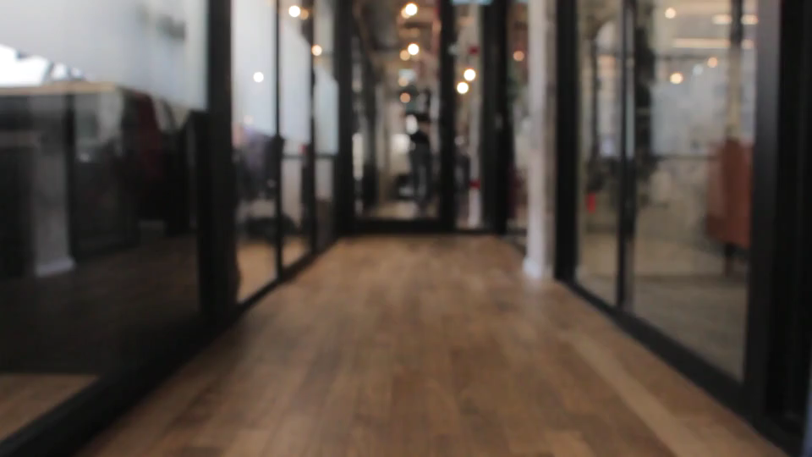
HW04 職場故事
Notes:
來源: https://pixabay.com/videos/busy-office-people-indoors-4723/

Slide 2

1. 目標
Notes:
來源: https://pixabay.com/videos/office-skyscraper-ray-sun-windows-45985/

Slide 3

2. 阻礙
Notes:
來源: https://pixabay.com/videos/computer-keyboard-typing-white-3188/

Slide 4
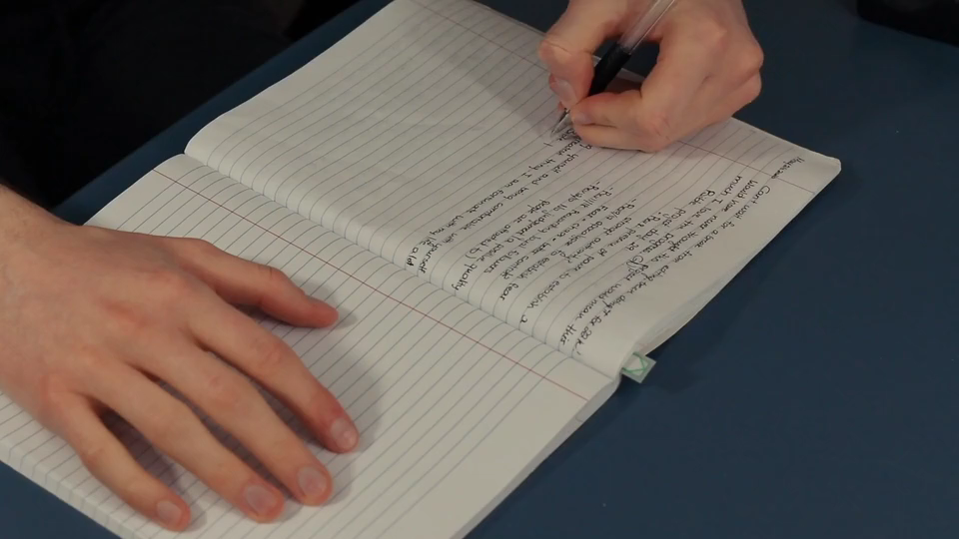
3. 努力
Notes:
來源: https://pixabay.com/videos/writing-journal-desk-typewriter-43869/

Slide 5

4. 結果
Notes:
來源: https://pixabay.com/videos/work-space-meeting-startup-notebook-3132/

Slide 6

5. 意外
Notes:
來源: https://pixabay.com/videos/talk-discussion-meeting-team-group-1112/

Slide 7

6. 轉折
Notes:
來源: https://pixabay.com/videos/compass-solution-conceptual-224245/

Slide 8

7. 結局
Notes:
來源: https://pixabay.com/videos/keyboard-hands-writing-computer-1046/

